Slide 1

Title NYPD Crime Data Analysis with Machine Learning Model
Predicting Crime Severity in New York City -2024

Slide 2
Introduction
Objective: The objective of this project is to analyze crime data from New York City and build machine learning models to predict the severity of crimes, specifically focusing on distinguishing felony crimes from non-felony (misdemeanor and violation) crimes.
Key Goals:
Analyze: Explore patterns and trends in NYC crime data.
Predict: Develop models that can classify crime severity (Felony, Misdemeanor, Violation.
Evaluate: Measure model performance using accuracy, precision, and recall.

Slide 3
Dataset Overview
Dataset:
Contains approximately 70,000 rows and 38 columns representing complaints reported to the NYPD.
Key features include:
Borough: Location where the crime occurred.
Crime Category: Felony, Misdemeanor, Violation.
Victim and Suspect Details: Age, Race, Sex.
Geographical Coordinates: Latitude, Longitude.
Initial Cleaning:
Handled missing values (e.g., NaN, null).
Encoded categorical columns for model compatibility.
Dropped irrelevant columns such as complaint numbers and unnecessary spatial data.

Slide 4
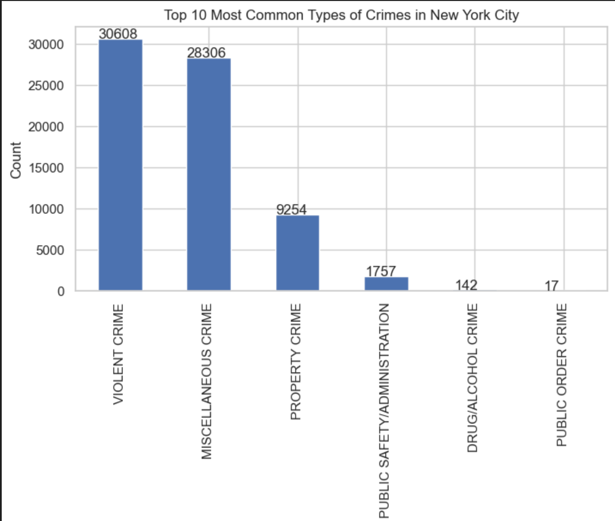
This chart highlights that Violent Crimes and Miscellaneous Crimes dominate the crime landscape in New York City. Violent crimes such as assault and robbery make up the largest category. Property crimes, while less frequent, still represent a significant portion of overall criminal activities.

Slide 5
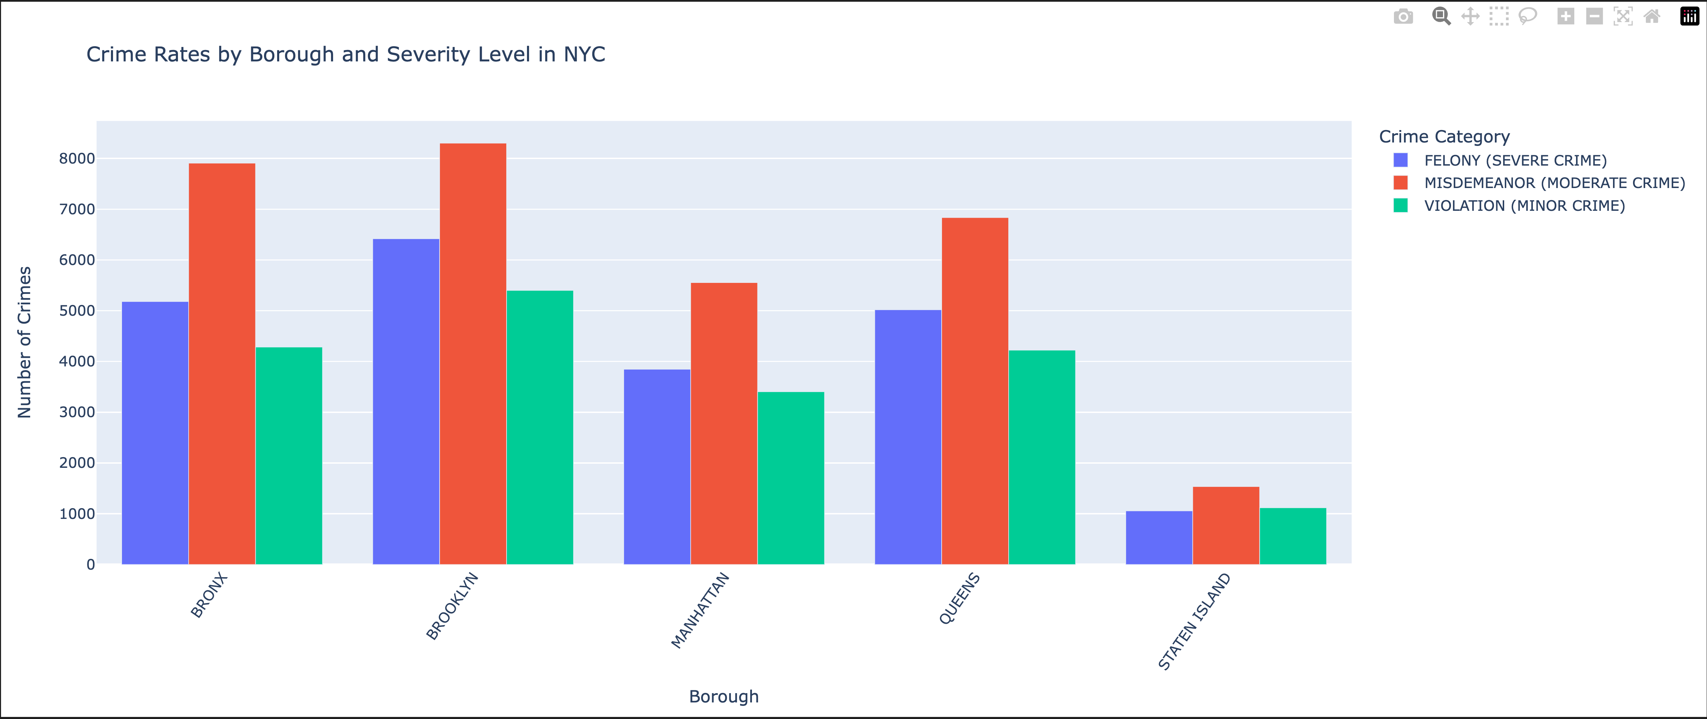
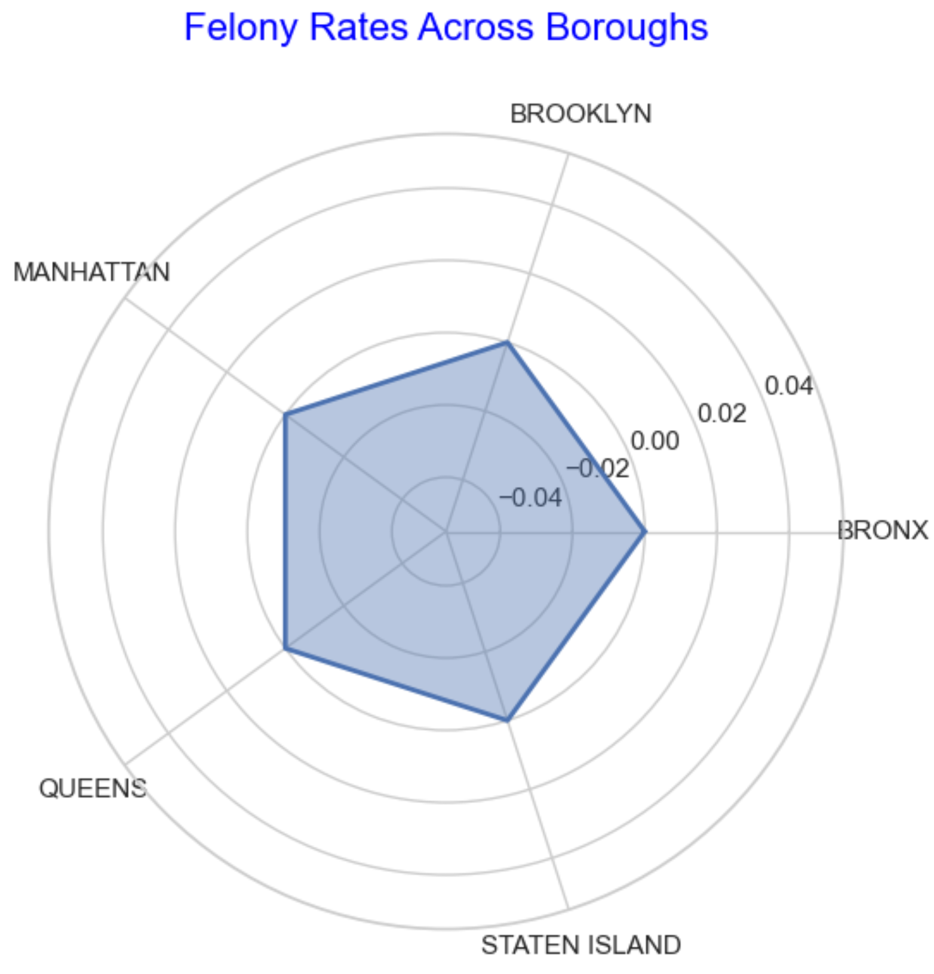
Brooklyn and the Bronx experience higher felony rates compared to other boroughs. Misdemeanors are more evenly distributed across all boroughs, with Queens and Manhattan showing a higher prevalence. Staten Island reports lower crime overall across all categories.
Although there is some variation, Brooklyn and the Bronx show slightly higher felony rates than other boroughs. This chart allows us to visually compare felony distributions across different areas.

Slide 6
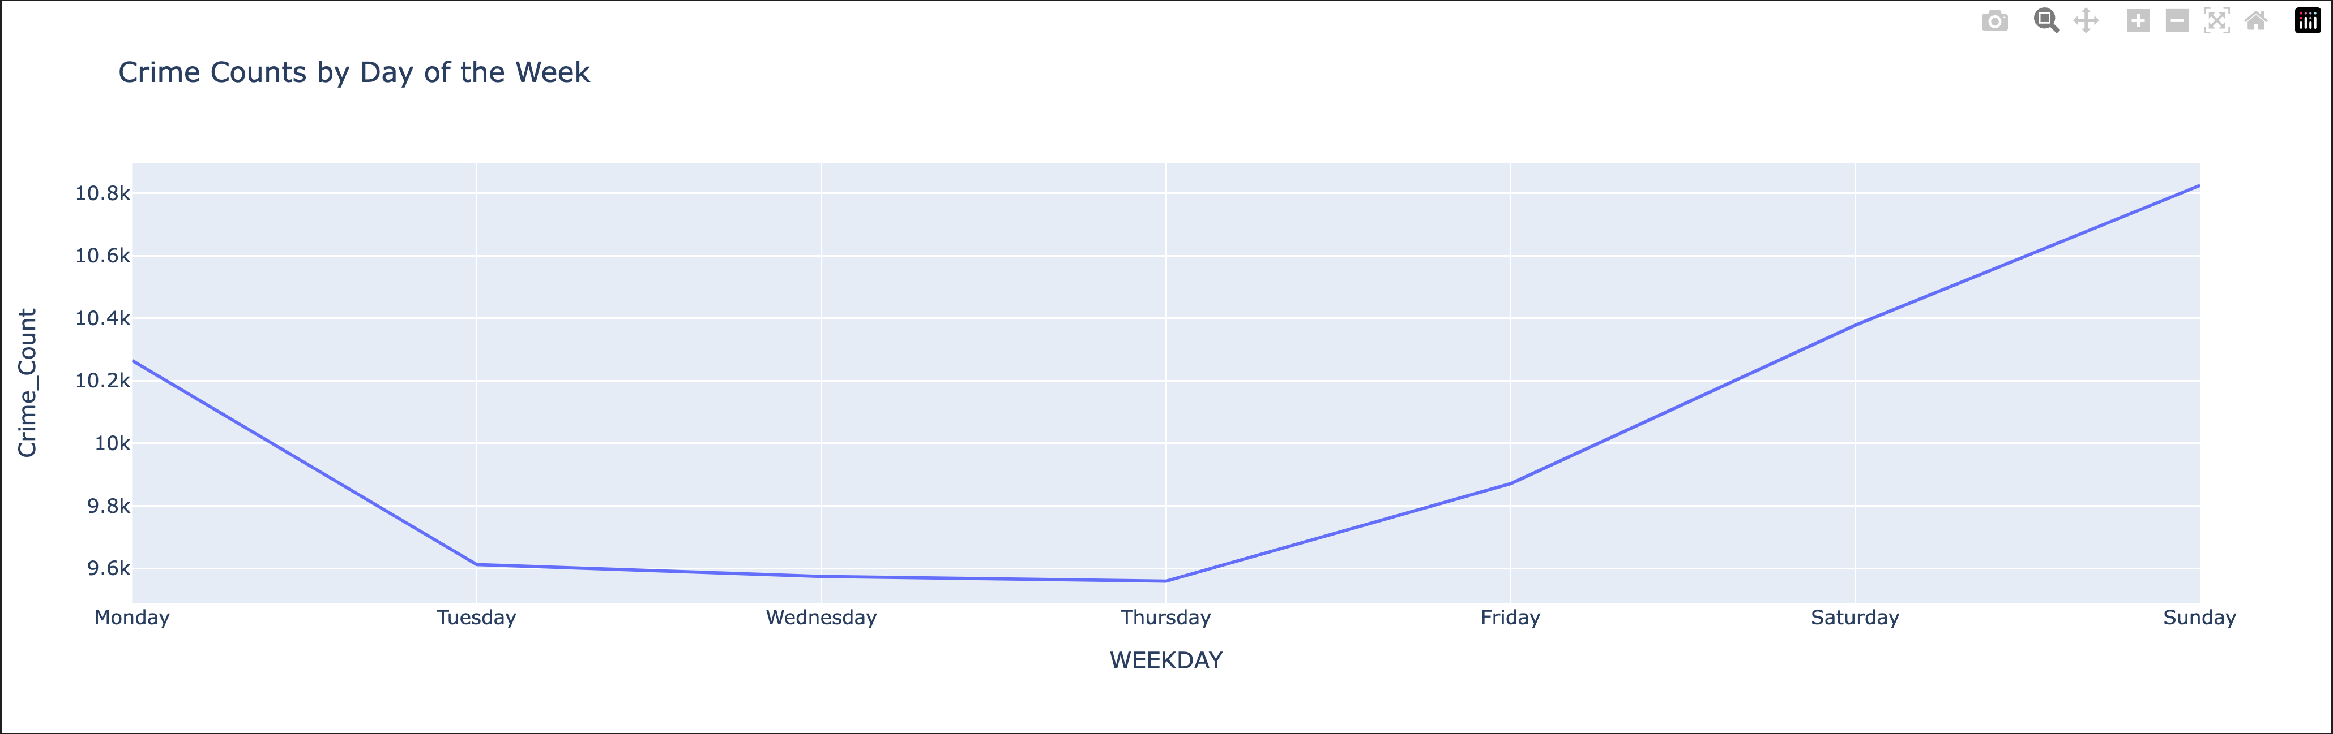
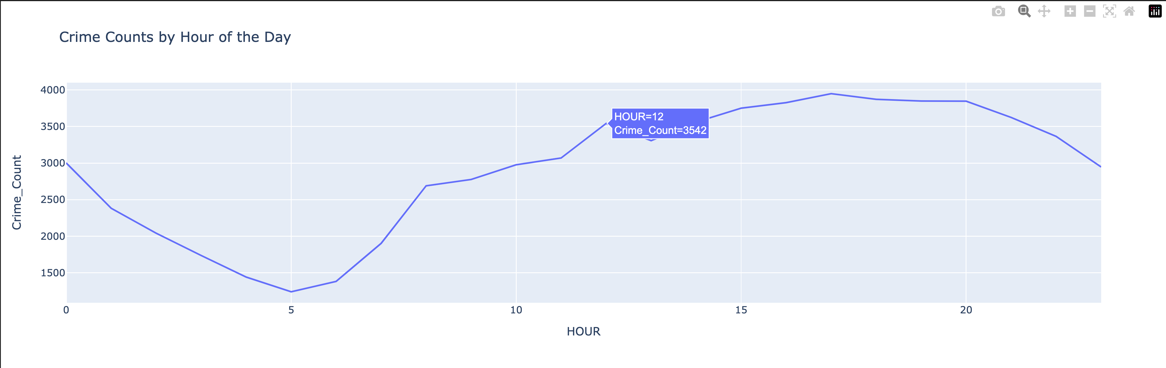
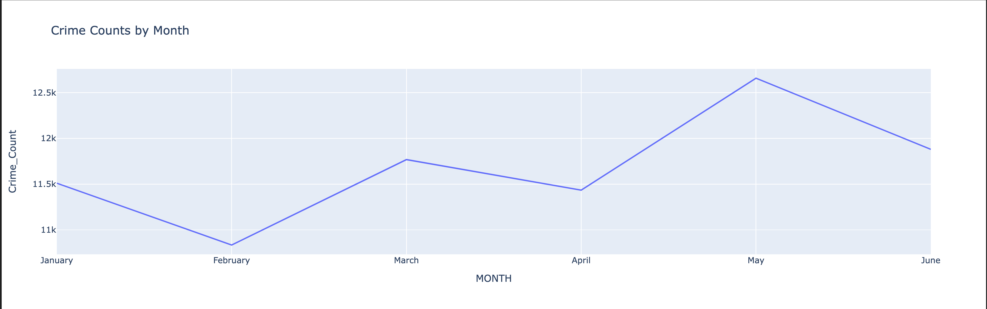
Crime by Day: Crime rates spike on weekends, particularly Sundays, indicating more criminal activity during leisure periods.
Crime by Hour: Crime increases throughout the day, peaking in the late evening around 9 PM.
Crime by Month: Crime fluctuates throughout the year, with May reporting the highest number of crimes.

Slide 7
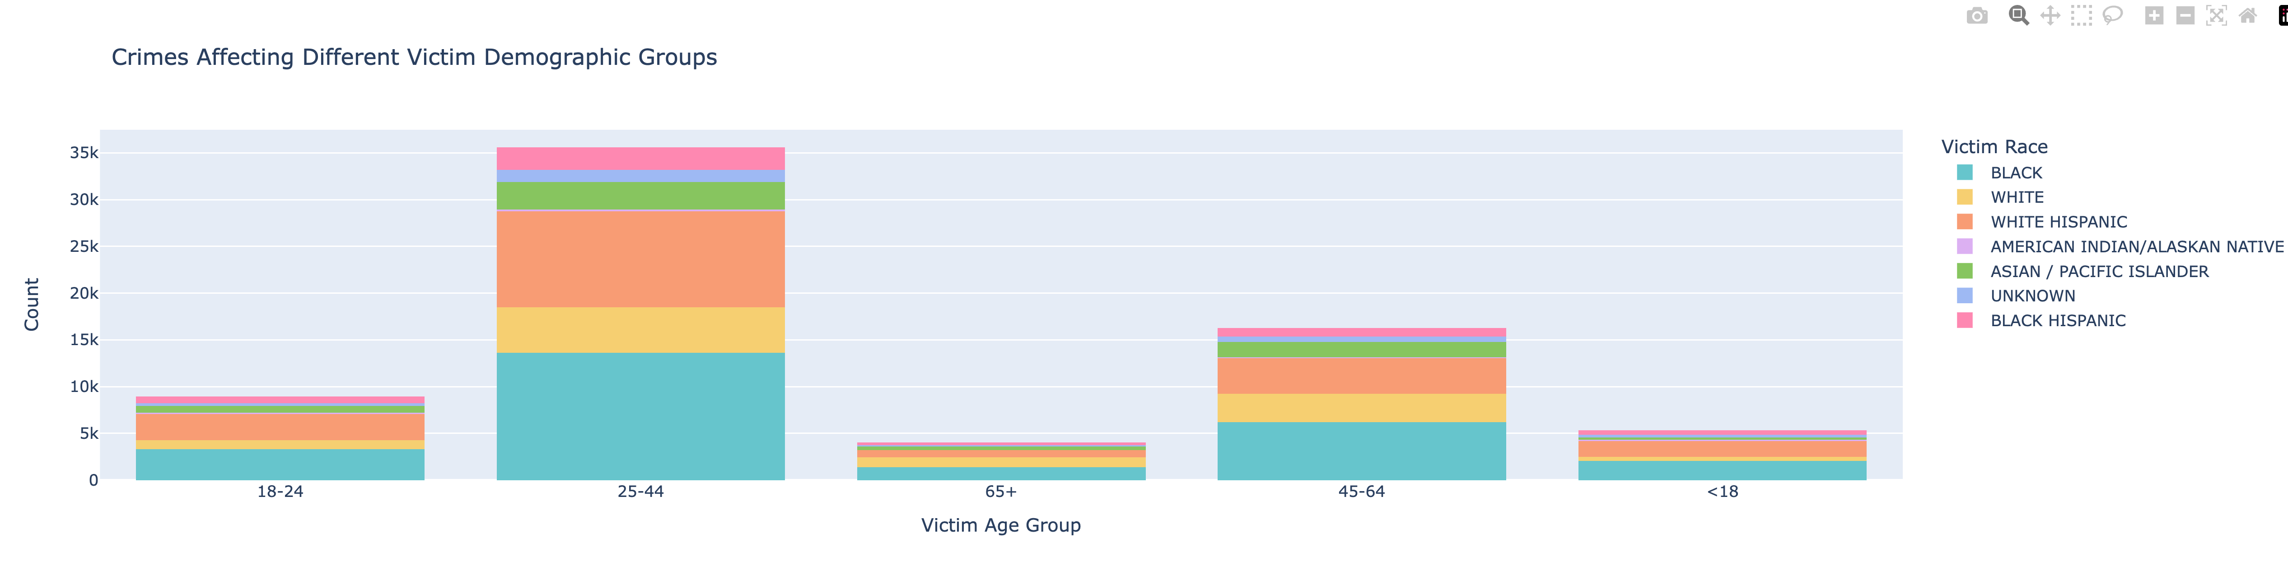
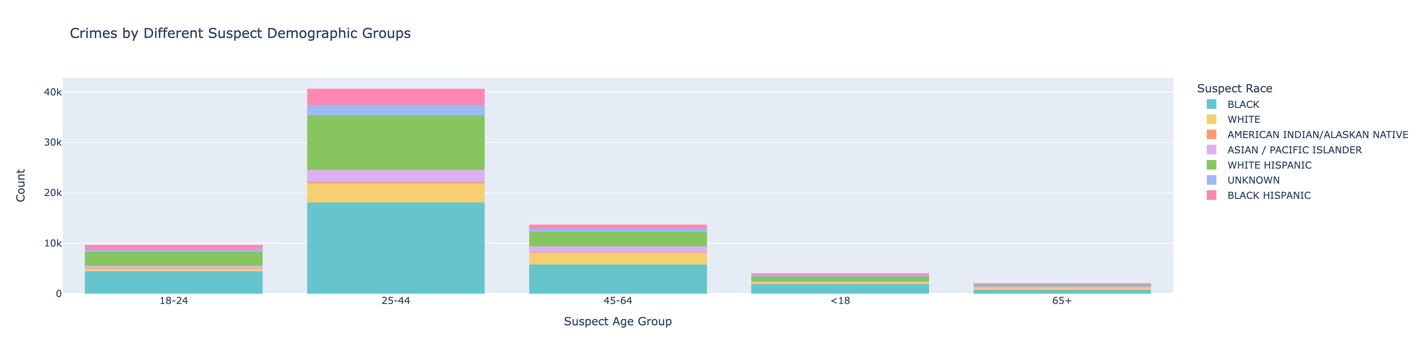
Victims 25-44 age group is the most affected across all racial groups, particularly among Black and Hispanic victims. The data shows the majority of crimes affect younger and middle-aged individuals.
Suspects are predominantly from the 25-44 age group, with Black and Hispanic individuals forming the largest racial group of suspects. This visualization helps compare the alignment between victim and suspect profiles.

Slide 8
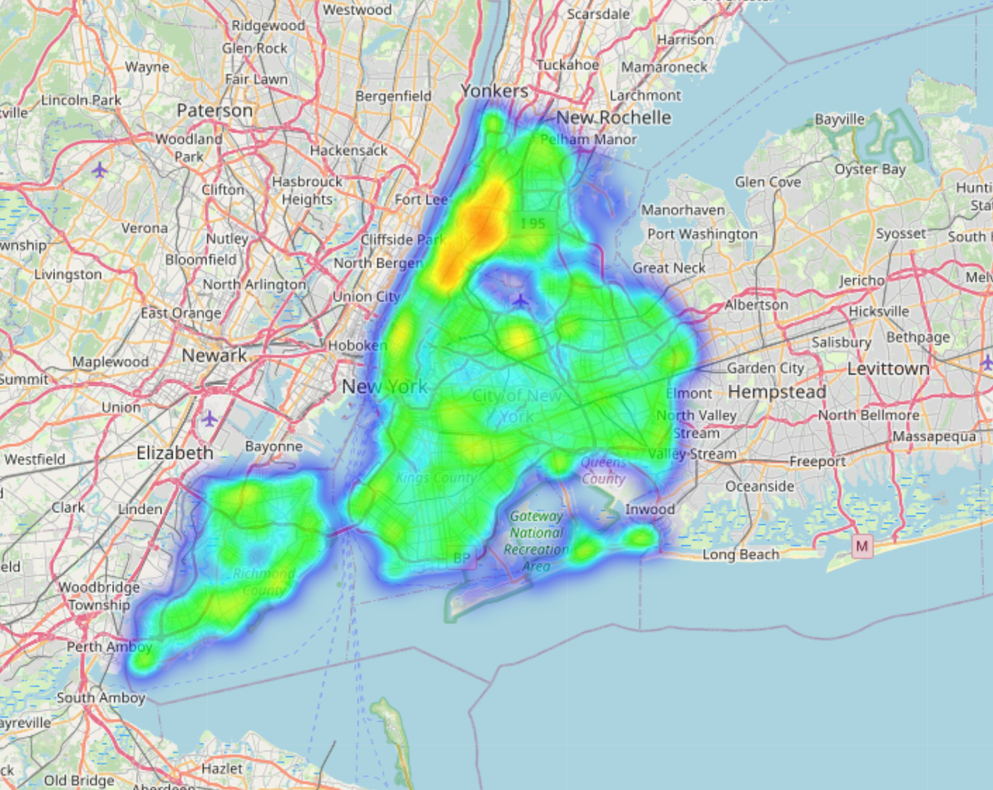
This heatmap shows the areas with the highest concentrations of crime in NYC. Areas like Brooklyn and parts of Manhattan emerge as crime hotspots. These insights could be used for better resource allocation and crime prevention strategies.

Slide 9
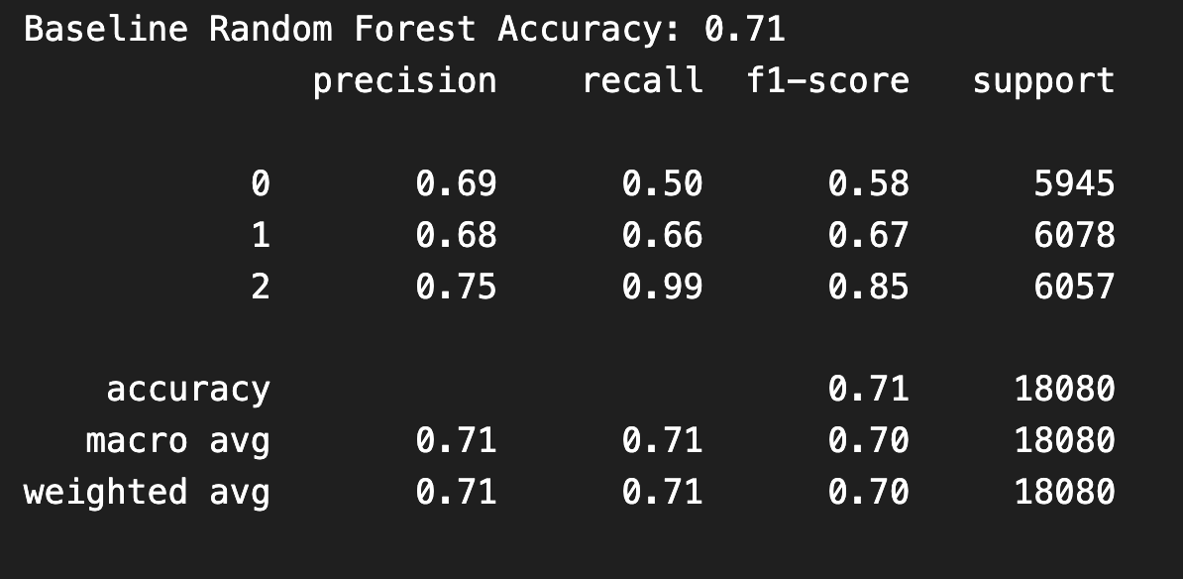
Model Training and Feature Preparation:
We first prepared the dataset by normalizing numerical features such as latitude and longitude using MinMaxScaler.
Categorical features such as suspect race, victim race, and age groups were label-encoded to convert them into numerical values that are suitable for machine learning models.
We also performed SMOTE (Synthetic Minority Over-sampling Technique) to balance the class distribution since felonies were underrepresented compared to misdemeanors and violations.
Random Forest Model
Baseline Model - Random Forest Classifier:
We used a Random Forest Classifier to train the initial model with 100 estimators.
The accuracy score of the baseline Random Forest model reached 0.71, indicating that the model was fairly accurate in classifying the crime severity types.
The classification report shows a strong precision and recall for felonies (class 2), with precision at 0.75 and recall at 0.99. The other classes, misdemeanors (class 1) and violations (class 0), showed slightly lower performance.

Slide 10

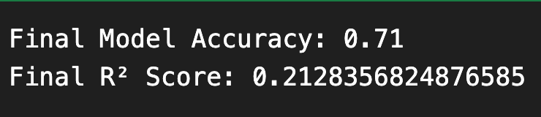
Cross-Validation:
We performed 5-fold cross-validation on both logistic regression and random forest models.
The cross-validation accuracy for logistic regression was 0.61 ± 0.04, while for random forest it was 0.44 ± 0.04. This shows that random forest had higher variance in its performance, but logistic regression had more stable performance across folds.
After applying hyperparameter tuning and model optimization, the final accuracy of the Random Forest model was 0.71.The R² score was 0.21, which indicates that while the model is able to classify most cases correctly, there is still some room for improvement in capturing the variance in the data.The model performed particularly well in predicting felonies but showed lower performance in predicting violations and misdemeanors, which can be attributed to the class imbalance despite SMOTE being applied.

Slide 11
Neural Network Model
The goal of implementing a neural network model was to build a non-linear classifier capable of recognizing patterns in the encoded NYPD crime dataset. We used a Multi-Layer Perceptron (MLP) with the ReLU activation function to train on the scaled and encoded data, which allows the model to learn complex relationships between the features and the target variable (LAW_CATEGORY_CODE)
Key parameters:
Activation function: ReLU (Rectified Linear Unit), which is commonly used for its ability to introduce non-linearity while being computationally efficient.
Number of hidden layers: The MLP uses a hidden layer with 50 nodes.
Learning rate: Initially set to 0.001 to control the step size during the optimization process.
Max iterations (epochs): We set the max iteration to 100, ensuring enough training epochs for the model to converge.

Slide 12
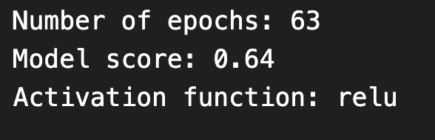

Results
Results (Before Optimization):
Number of epochs: The model trained for 63 epochs.
Model score: Achieved an initial accuracy of 64%.
Although the initial score showed some promise, it was clear that further optimization was needed to improve the model’s accuracy and generalization performance on unseen data.
Optimization Process: To improve the neural network model's performance, we used a GridSearchCV for hyperparameter tuning. This process helped find the best combination of hyperparameters to maximize the model’s accuracy.
Results (After Optimization):
Despite the optimization, the accuracy slightly decreased, suggesting that the neural network model may not be the best fit for this dataset, compared to other models like Random Forest, which achieved better results.

Slide 13
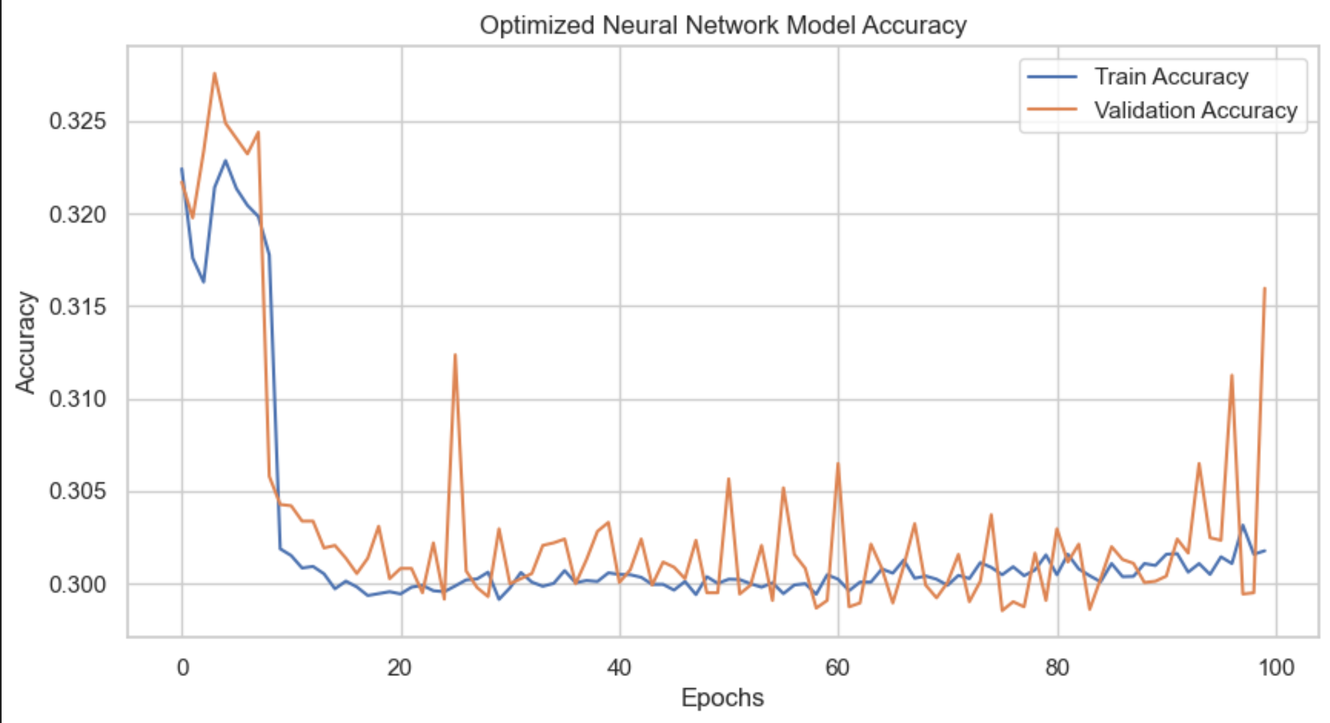
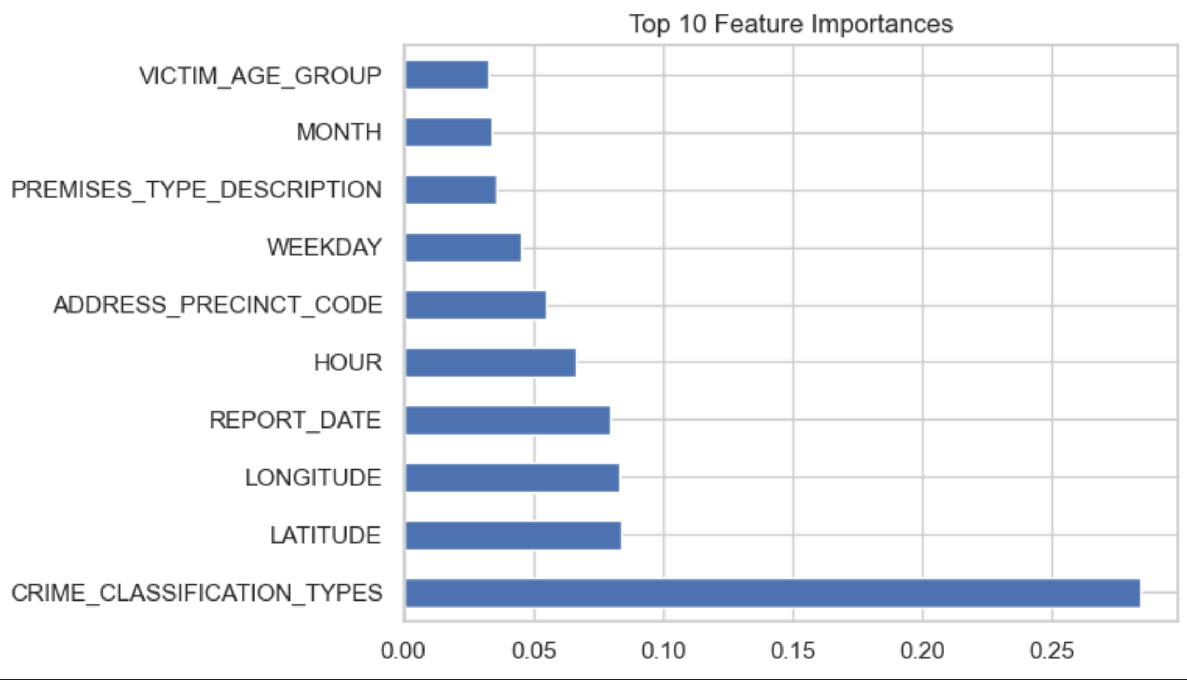
Optimized Neural Network: After tuning the neural network with ReLU activation and 50 hidden units, the accuracy reached 59%. This indicates moderate performance, with the model needing further optimization to handle more complex patterns.
Random Forest: The Random Forest model achieved 71% accuracy, outperforming the neural network. Feature importance analysis from the Random Forest highlights which features contribute most to crime prediction.
This side-by-side comparison shows that the Random Forest model is more effective for this dataset, although the neural network may be improved with further tuning.

